Slide 1


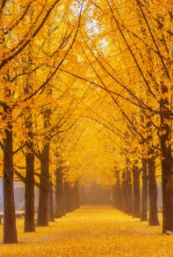
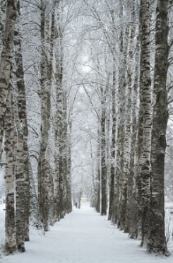






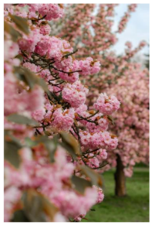
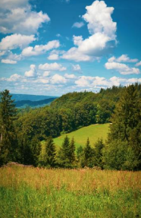






Year 1: Seasonal changes
Knowledge Organiser
Careers connected to this unit: climate scientist, meteorologist, weather presenter
Key vocabulary
Autumn
Winter
Season
Spring
Summer
Autumn
Winter
Change
Weather
Hibernate
Migrate
Temperature
Rotate
Deciduous
Evergreen
Leaves
Blossom
Flowers
Seeds
Bulbs
In autumn, the weather turns cold and it might rain.
Winter is the coldest season, with short days
and long nights.
Some leaves turn orange and fall from trees.
Some plants stop growing and many trees are bare.
Some animals prepare for the winter.
It sometimes snows and water can freeze, making ice.
Spring
Summer
In spring the weather warms up, but we see lots of rain.
Summer is the warmest season, with lots of sunshine.
Flowers blossom and trees grow green leaves.
People wear light clothes and play outside lots.
Some baby animals are born.
The days are longer and the evenings are shorter.
Developing Experts Copyright 2025 All Rights Reserved

Slide 2

Year 1: Seasonal changes
Knowledge Organiser
Careers connected to this unit: climate scientist, meteorologist, weather presenter
Rocket Words
season | one of four parts of the year; spring, summer, autumn and winter
spring | the season when flowers start to grow and animals have babies
winter | the season when it is cold, the days are short and sometimes it snows
autumn | the season when leaves change colour and all off some trees
summer | the season when it is hot and sunny and the days are long
hibernate | to sleep though winter
temperature | how warm or cool something is
weather | what happens outside each day like sunshine, rain, snow or wind
rainfall | the amount of rain that falls from the sky
Developing Experts Copyright 2025 All Rights Reserved

